Slide 1
Lesson 13 – Homework review

Slide 2
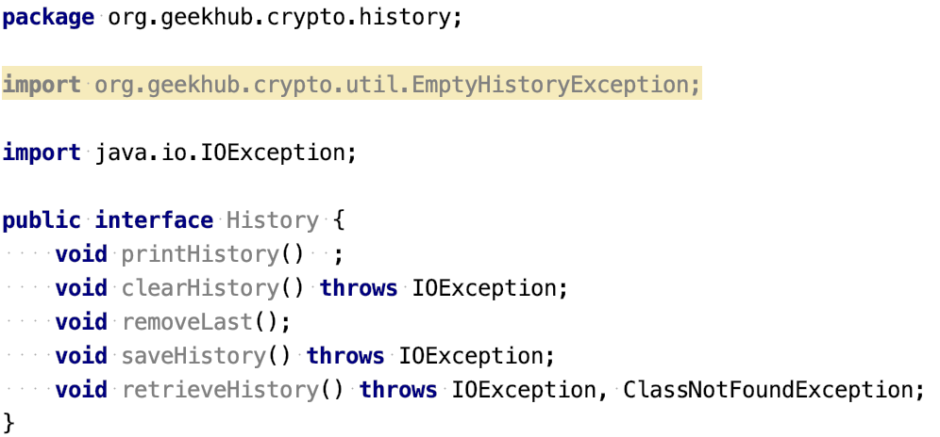
Don’t commit unused code

Slide 3
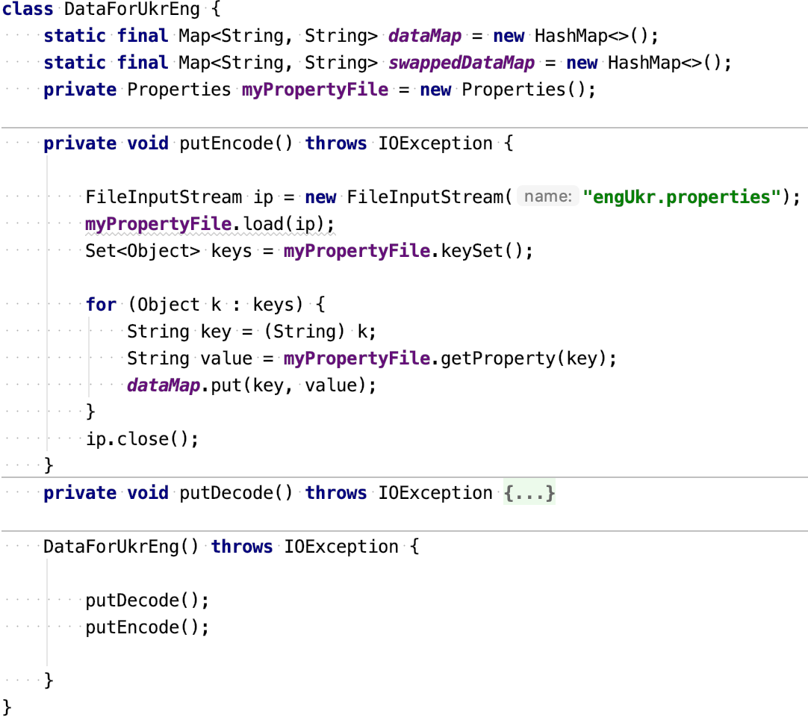
Follow Code Style Conventions

Slide 4
Follow Code Style Conventions

Slide 5
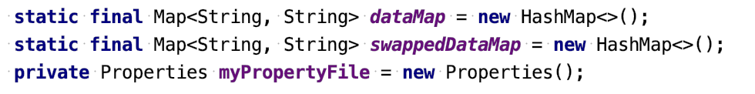
Clear Variable Names

Slide 6
Clear Variable Names

Slide 7
Follow DRY principle

Slide 8
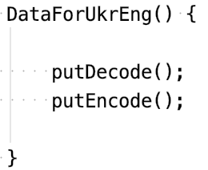
Exceptions and Constructors

Slide 9
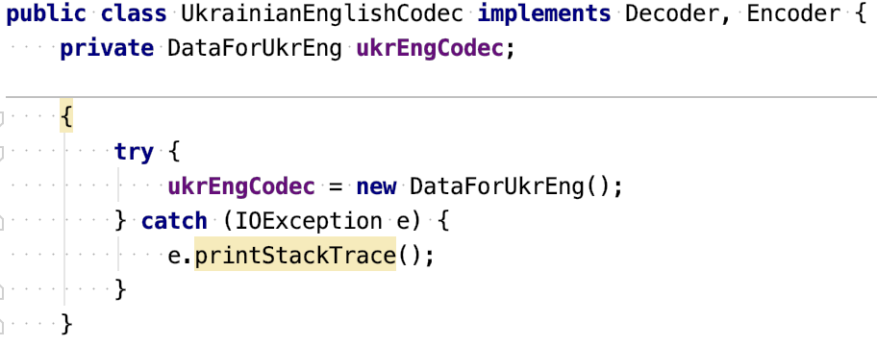
Avoid initialization blocks

Slide 10
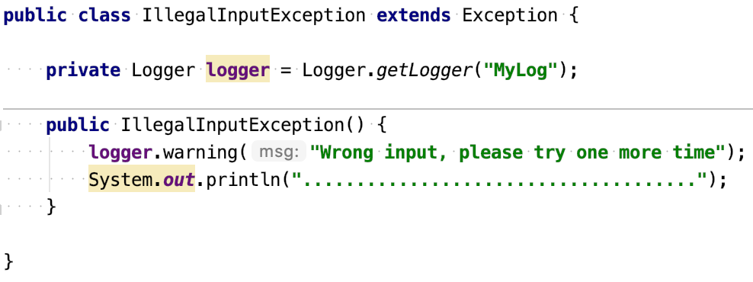
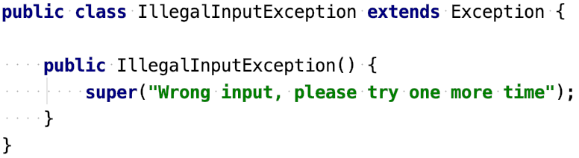
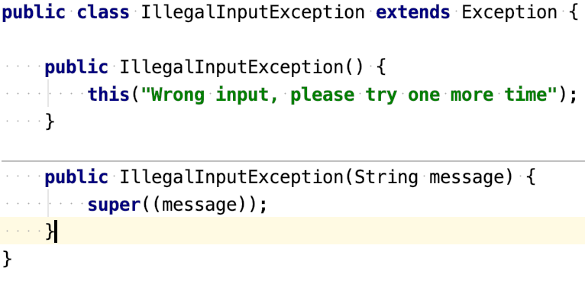
Exception classes responsibility

Slide 11
Exception classes responsibility

Slide 12
Exception classes responsibility

Slide 13
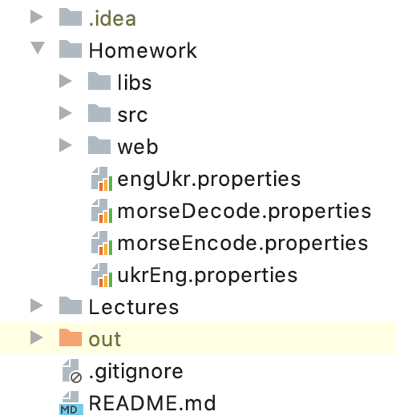
Resources storing

Slide 14
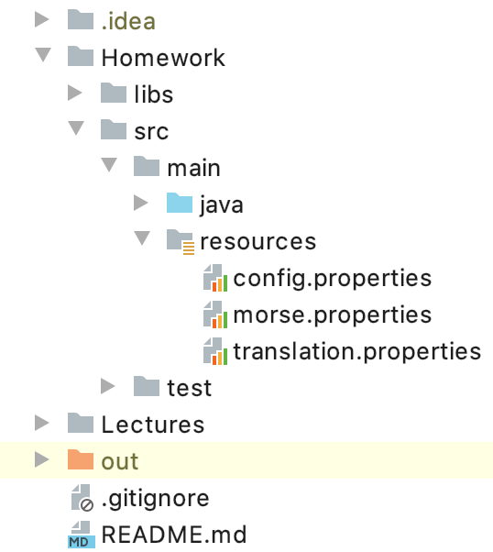
Resources storing

Slide 15
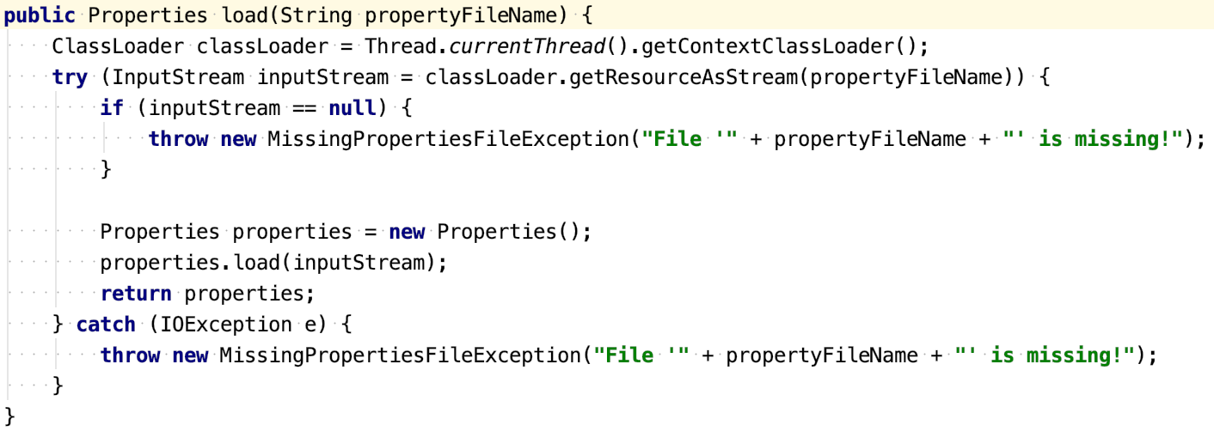
Correct Resources Loading

Slide 16
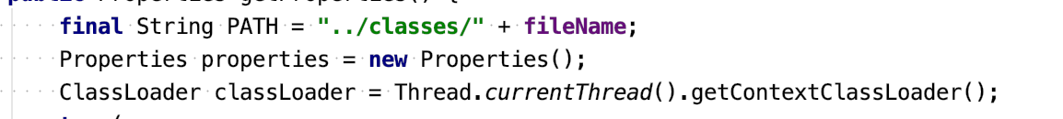
Use not hardcoded paths to resources

Slide 17
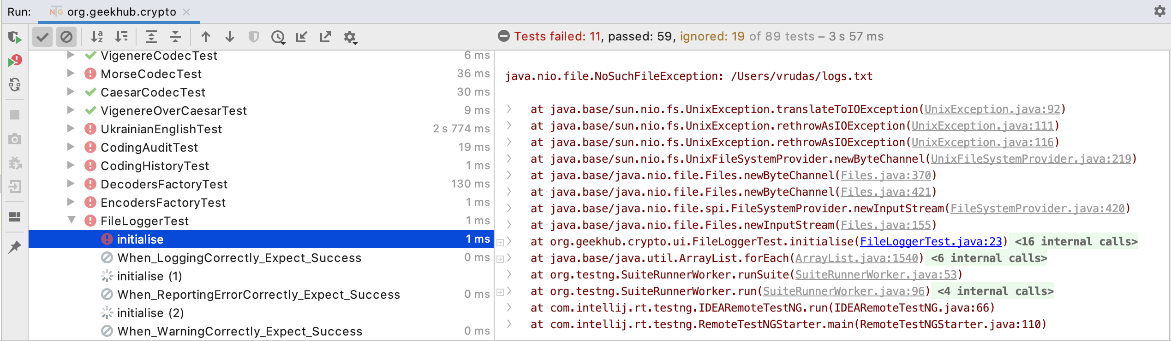
Run tests before push

Slide 18
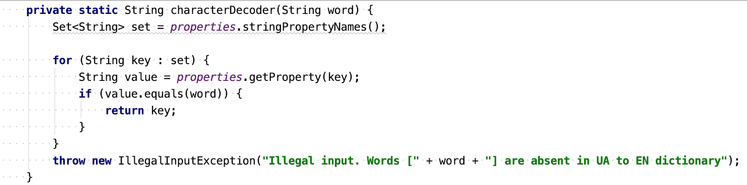
Prefer ”reversed map” over iteration

Slide 19
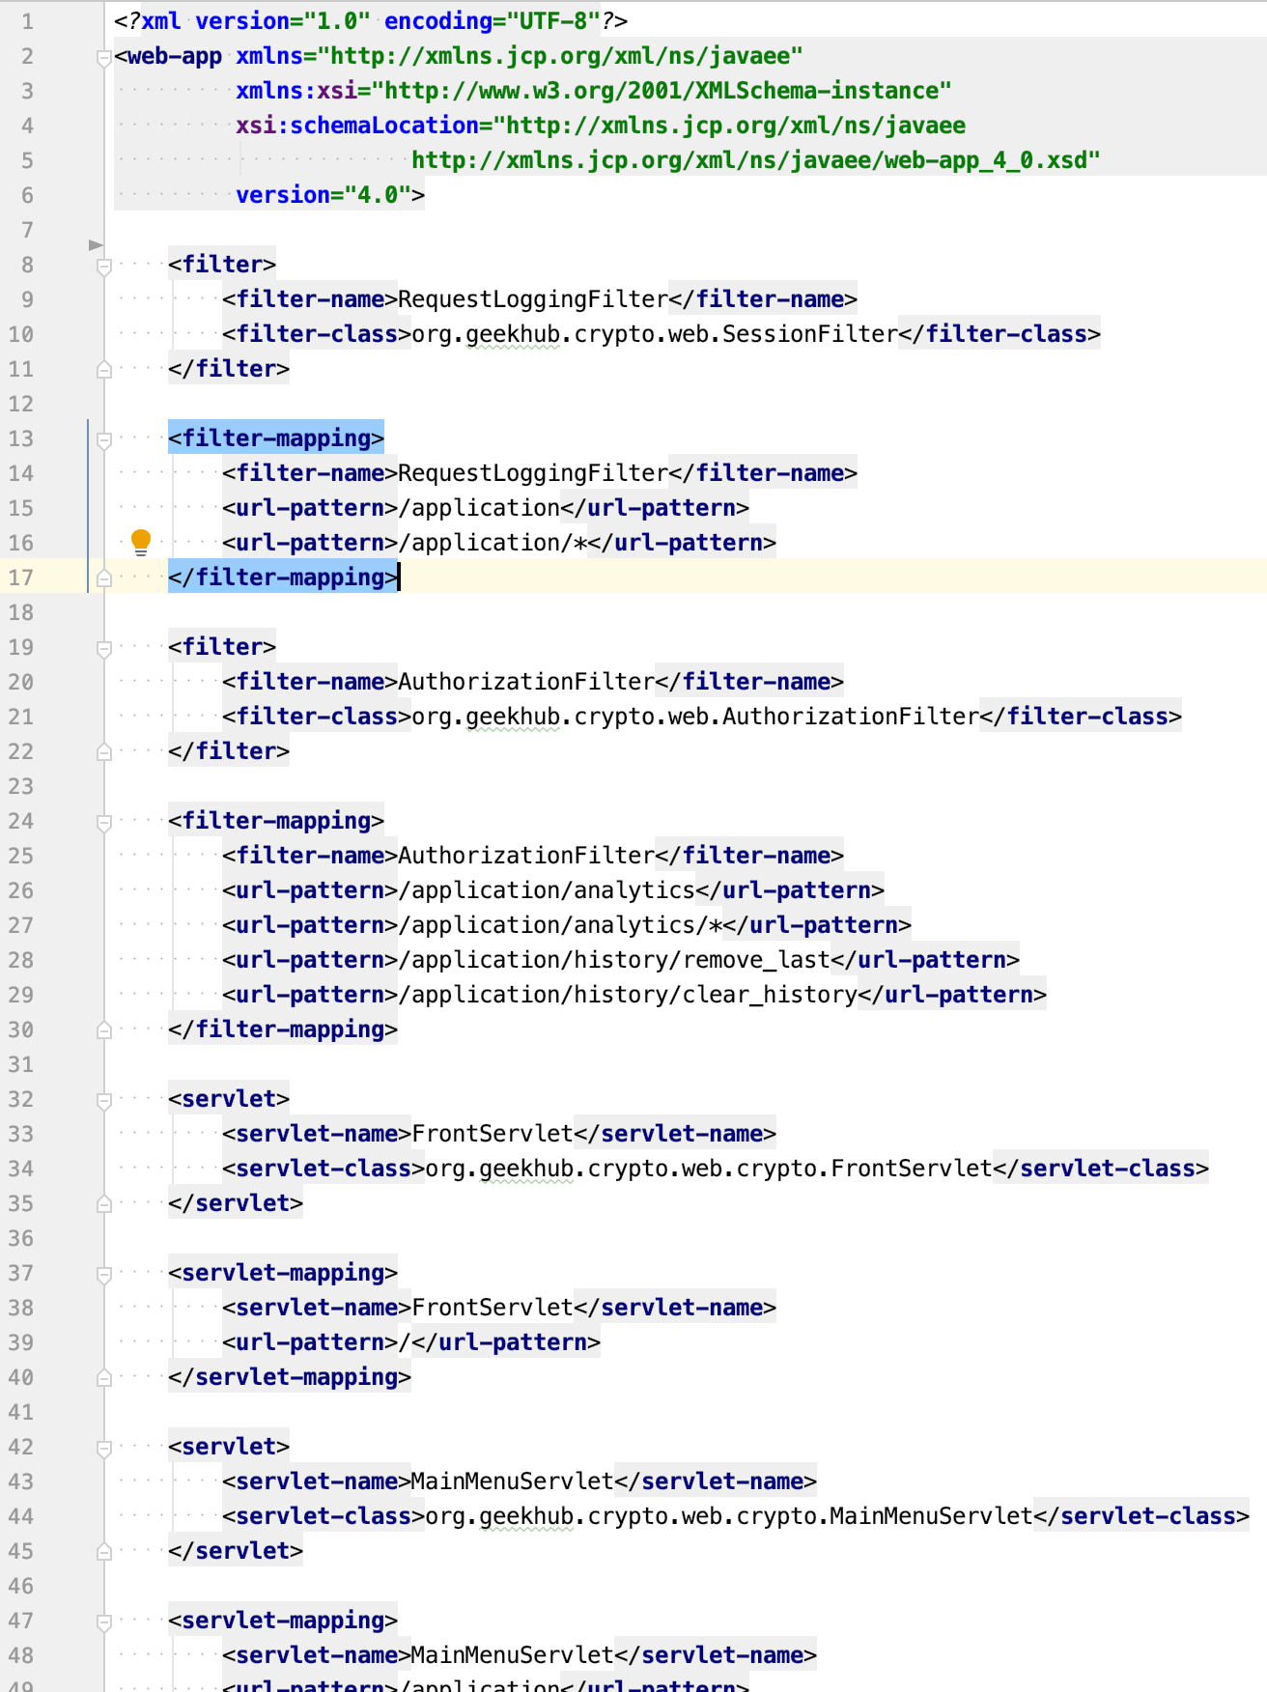
Prefer annotation config over xml
@WebServlet(name = "ServletName", urlPatterns = {"/"})
<servlet> <servlet-name>ServletName</servlet-name> <servlet-class>org.geekhub.crypto.web.ServletName</servlet-class> </servlet> <servlet-mapping> <servlet-name>ServletName</servlet-name> <url-pattern>/</url-pattern> </servlet-mapping>

Slide 20
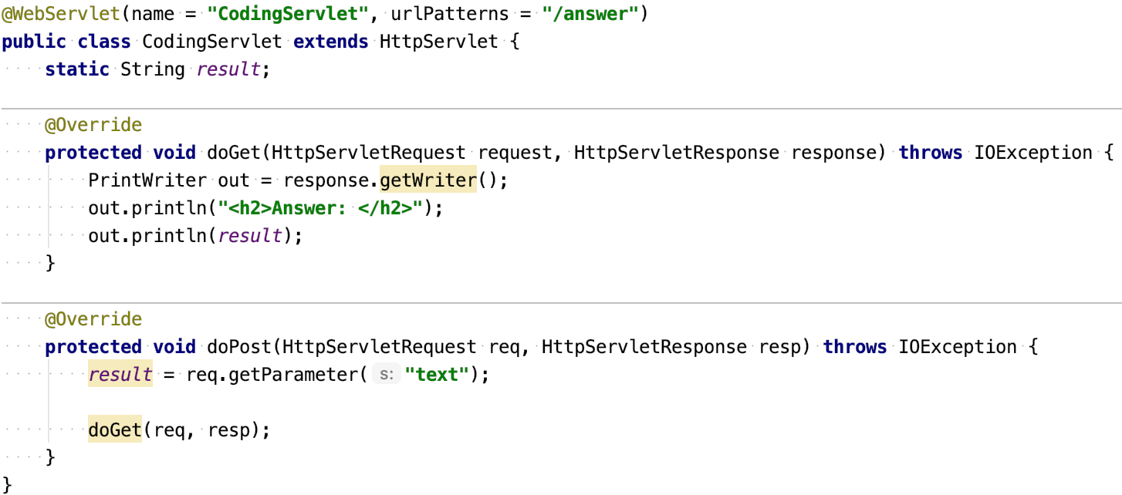
Follow KISS principle

Slide 21
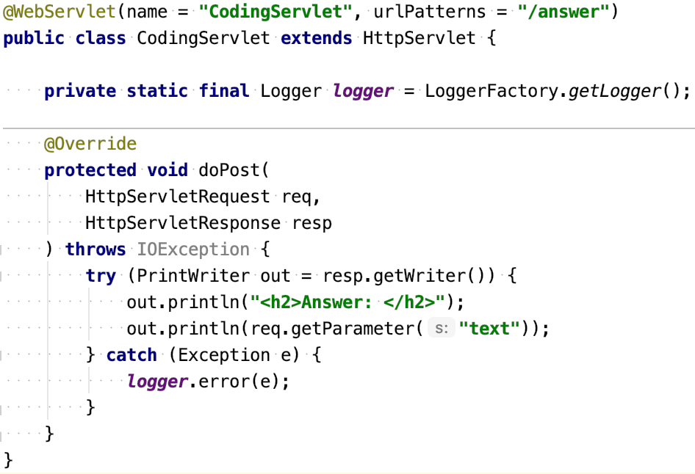
Follow KISS principle

Slide 22
Apply recommendations from personal feedbacks before starting next homework

